Slide 1
CHECKPOINT ASP.NET CORE WEB APPLICATION
MVC Architecture, Cookie Security & Directory Operations
A comprehensive breakdown of multi-layer web architecture, EF Core database management, Cookie Authentication, and full CRUD workflows.
ASP.NET Core 10 MVC
Cookie Authentication
EF Core & SQLite

Slide 2




SYSTEM ARCHITECTURE
Core Technology Stack
ASP.NET Core MVC
EF Core & SQLite
Cookie Auth
Bootstrap 5 UI
Clean separation of Concerns with Models, Razor Views, and Controllers.
ORM database mapping with LINQ query execution.
Stateful session security with Encrypted Claims Principal.
Responsive layout forms, alerts, and table styles.

Slide 3

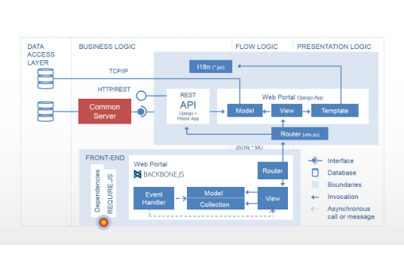
DESIGN PATTERN
Model-View-Controller Layering
Models (Data Structure)
Entity definitions for User credentials and Student directory attributes.
Views (Presentation)
Dynamic Razor templates (.cshtml) rendering responsive UI controls.
Controllers (Application Logic)
HTTP request handlers directing data processing and view routing.

Slide 4
PERSISTENCE LAYER
Data Models & Entity Framework Core
User Entity
Student Entity
ApplicationDbContext
Stores registered account profile and login credentials.
Stores directory record details for academic tracking.
Manages SQLite database connections and migrations.
EmailId, Password, Address, ContactNo
FirstName, LastName, Email, Course
DbSet, DbSet

Slide 5

AUTHENTICATION ARCHITECTURE
Cookie-Based Security Pipeline
Claims-Based Identity
Stores User ID and Email inside secure ClaimsPrincipal payload.
Encrypted Cookie Storage
Issues HttpOnly encrypted session cookies upon successful sign-in.
[Authorize] Attribute
Protects StudentController routes from unauthenticated access.

Slide 6



APPLICATION SECURITY
Defense Mechanisms & Validation
CSRF Protection
Model Validation
Client Scripts
[ValidateAntiForgeryToken] defends POST endpoints against cross-site forged requests.
DataAnnotations like [Required] and [EmailAddress] ensure server-side data integrity.
jQuery Unobtrusive validation provides immediate UI feedback without page reloads.

Slide 7
WORKFLOW DEMO
User Authentication Pipeline
01. Register
02. Verify
03. Authorize
04. Redirect
Create User
Login Post
Issue Cookie
Student Index
Submits account profile to database.
Checks email & password in EF Core.
Signs in ClaimsPrincipal instance.
Grants access to protected views.

Slide 8


CORE FEATURE
Student Directory Query Engine
Multi-Column Search
Dynamic Sorting
Bootstrap Table UI
Filters dynamically across Name, Email, and Course major via LINQ.
Toggles column sorts between ascending and descending order.
Clean table layout with hover states and action buttons.

Slide 9
DATA MANAGEMENT
CRUD Operations & TempData Notifications
Controller Operations
User Alerts (TempData)
Create: Inserts valid Student entity to EF Core.
Success Banners: Triggers dynamic alert popups upon saving.
Edit: Fetches existing student record by ID and updates details.
Error Banners: Displays validation failure notifications.
Delete: Removals safeguarded with confirmation prompts.
Auto-Dismiss: Dismissible Bootstrap alert components.

Slide 10
PROJECT COMPLETE
Summary & Live Demo Q&A
The CheckPoint application demonstrates clean MVC separation, secure Cookie Authentication, robust input validation, and full CRUD capability.
Repo: CheckPoint2App
Ready for Presentation

